Slide 1

Outlook Email-Tone Analyzer
HIGH
RISK

Slide 2
Objective
We Want To:
Allow Textron Employees to analyze their email before sending it to identify possible tone errors which could be seen as unprofessional or convey the wrong message.
Use collected data to identify stressful periods at individual Business Units and gain another perspective at business culture.

Slide 3

Technologies Used
IBM Watson API
Visual Studio 2017
Cloud Foundry
Languages
C#
Node.js
XML
Javascript

Slide 4


The Process

Slide 5
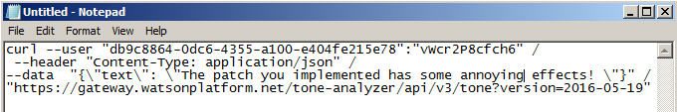
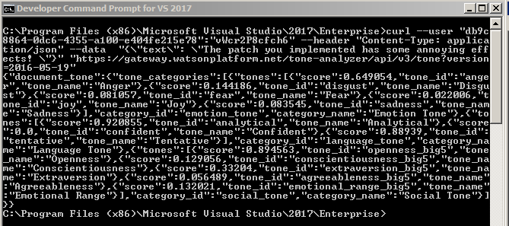

Slide 6
Challenges We Faced
Administrative Access Issues with Watson API
Parsing and Formatting XML
Auto-population of Email
Time

Slide 7
DEMO

